Slide 1

Mangrove Mapping
Grp 8
Notes:
https://code.earthengine.google.com/774456588694da514dde5743017f6031?accept_repo=users%2Fcrispliming%2FGEE101_students

Slide 2
Table of contents
01
02
03
Background
Carbon Trading
Our Solutions

Slide 3
01
Background
why are mangroves important?

Slide 4
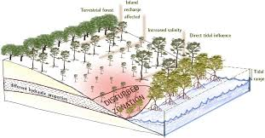

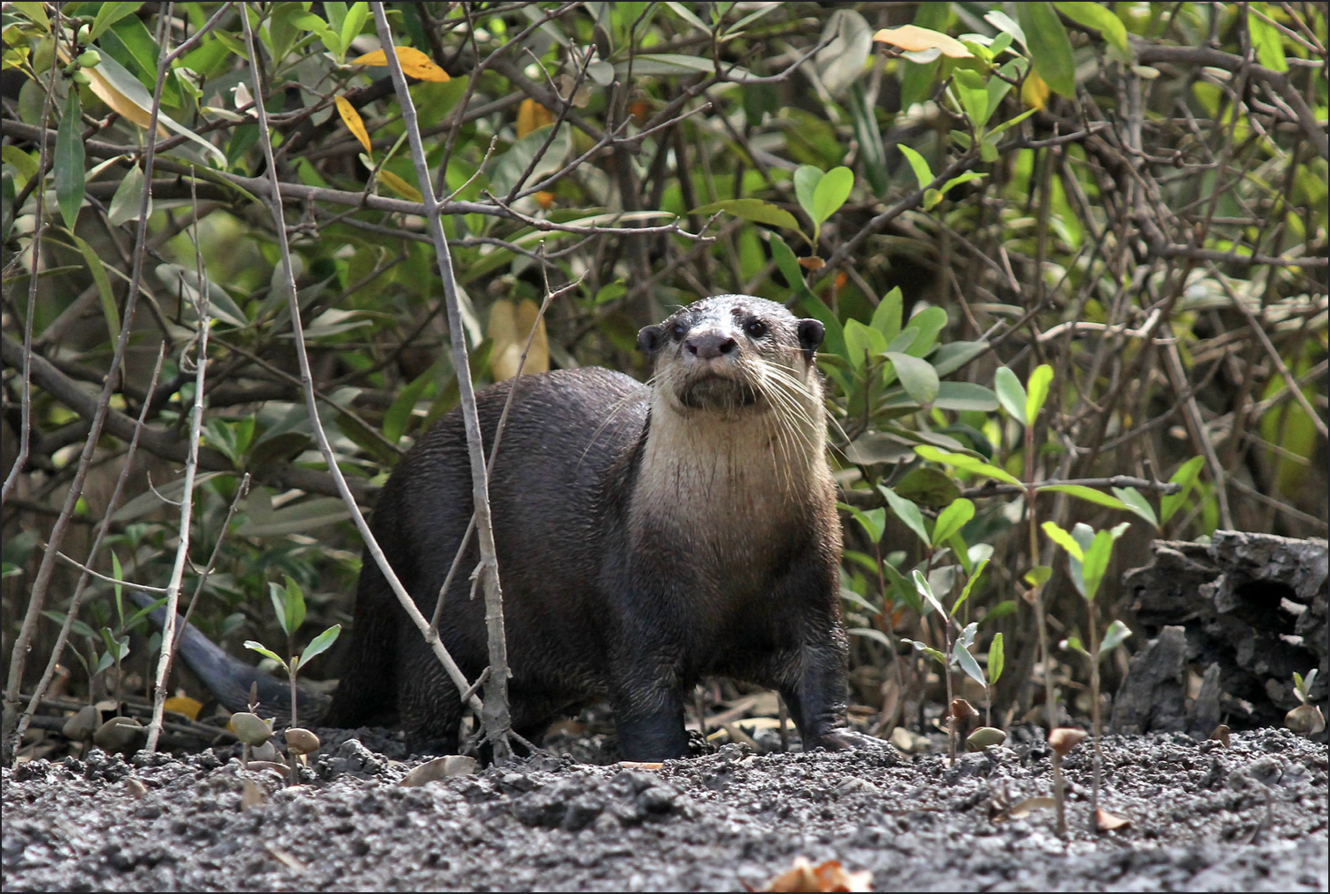
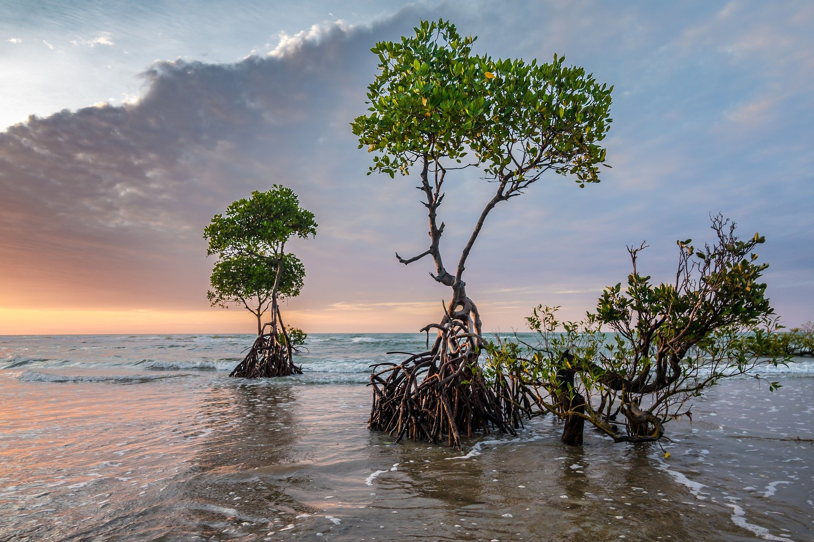

Slide 5



Slide 6

Cannot exceed certain levels of CO2!!!
Then how?

Slide 7
Plant more trees?
Intro to mangroves!

Slide 8
Mangroves are x4 better at absorbing CO2 than the amazon rainforest!!

Slide 9
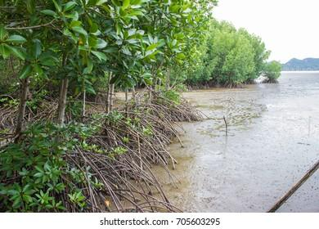
Bonus perk: Protects shoreline

Slide 10
02
Carbon Trading
why countries love (need) it

Slide 11
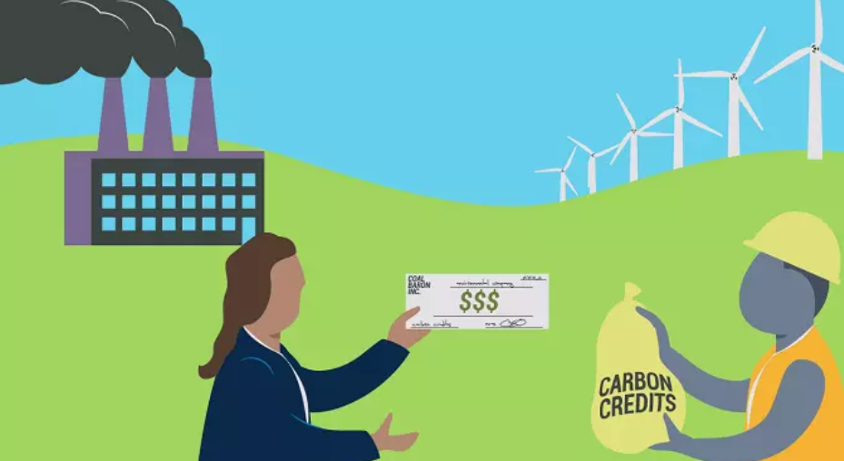


Slide 12
Consider: Using mangroves to offset carbon

Slide 13
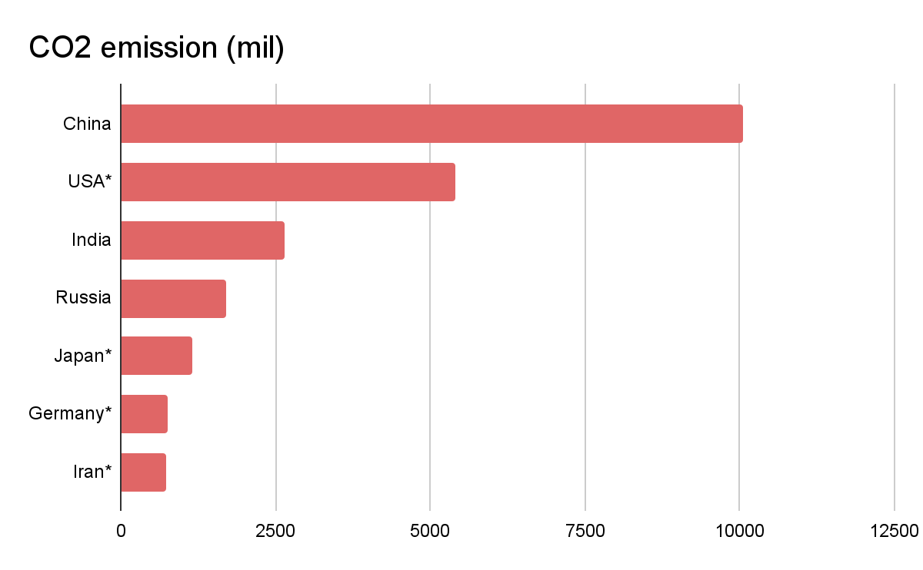
who may consider using mangroves?
*Countries that have little to no mangroves at all!!!
Notes:
This bar chart is about the top countries that produces a lot of carbon emission hence we can say that they need mangroves to reduce the amt of carbon released into the atmosphere.

Slide 14
03
How to identify the mangrove clusters?

Slide 15
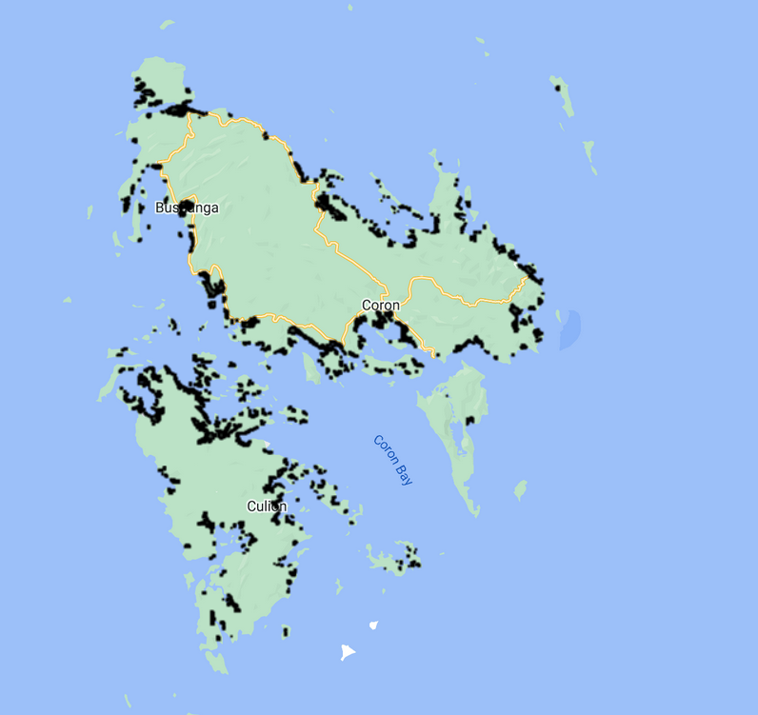
Remote islands in the Philippines:
Notes:
We can see that philippines has a large amount of mangrove.

Slide 16
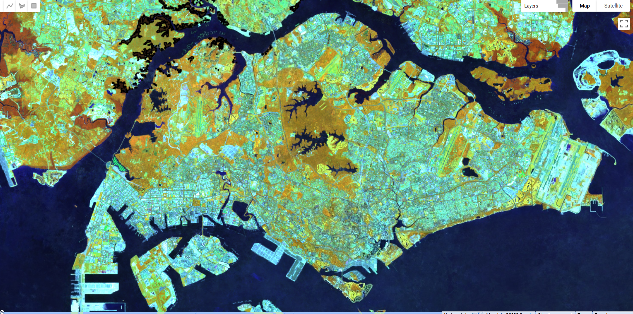
Sentinel-2 with MWI filter
Taken from GEE using sentinel-2

Slide 17
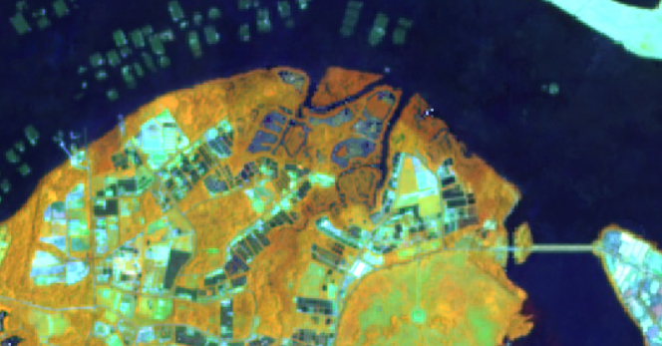
More brown!
Mangroves have a higher MVI index compared to other types of vegetation
Which is why the filter shows mangroves with a darker colour

Slide 18
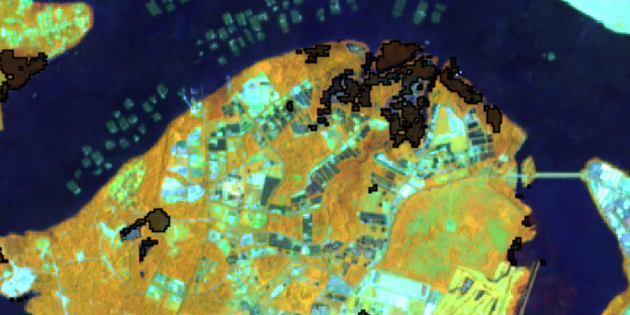
For easier visualization, set value of MWI from 4.5 to 5

Slide 19
How to calibrate/ensure accuracy?

Slide 20
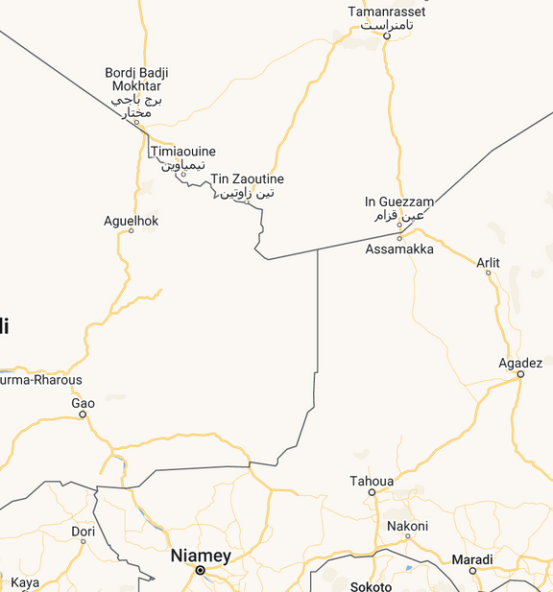
comparison: large & no amount of mangroves
VS
The Philippines
Africa

Slide 21
let's take a look at some potential target countries

Slide 22
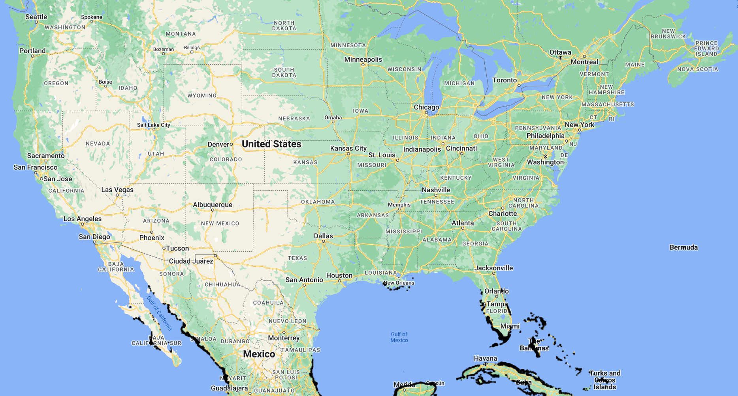
United States of America
belongs to mexico
Notes:
For example,

Slide 23
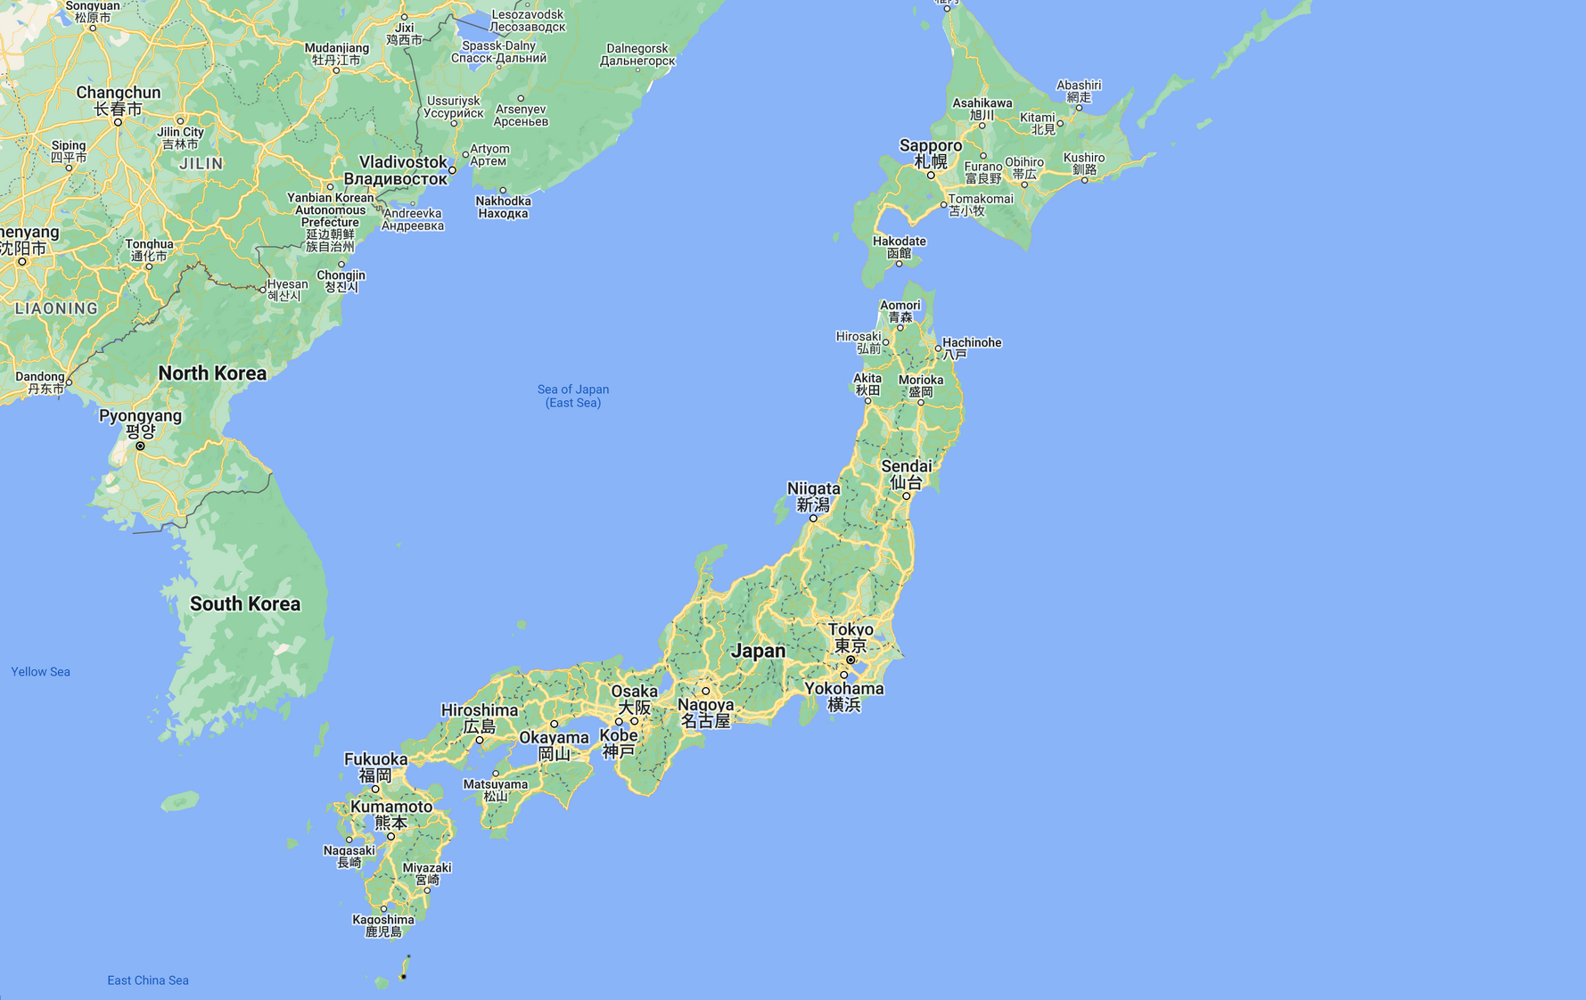

Japan**
Mangroves?
YAYAYAYAYAY

Slide 24
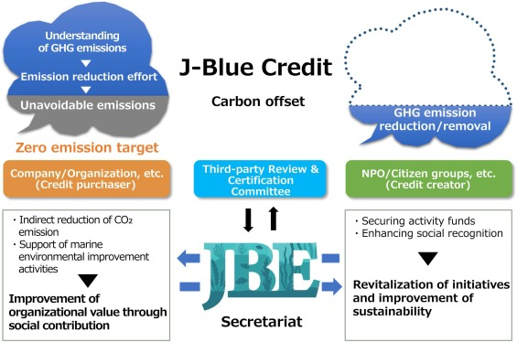
Japan is investing A LOT into offsetting carbon!!!

Slide 25
So which countries has plenty of mangroves?

Slide 26
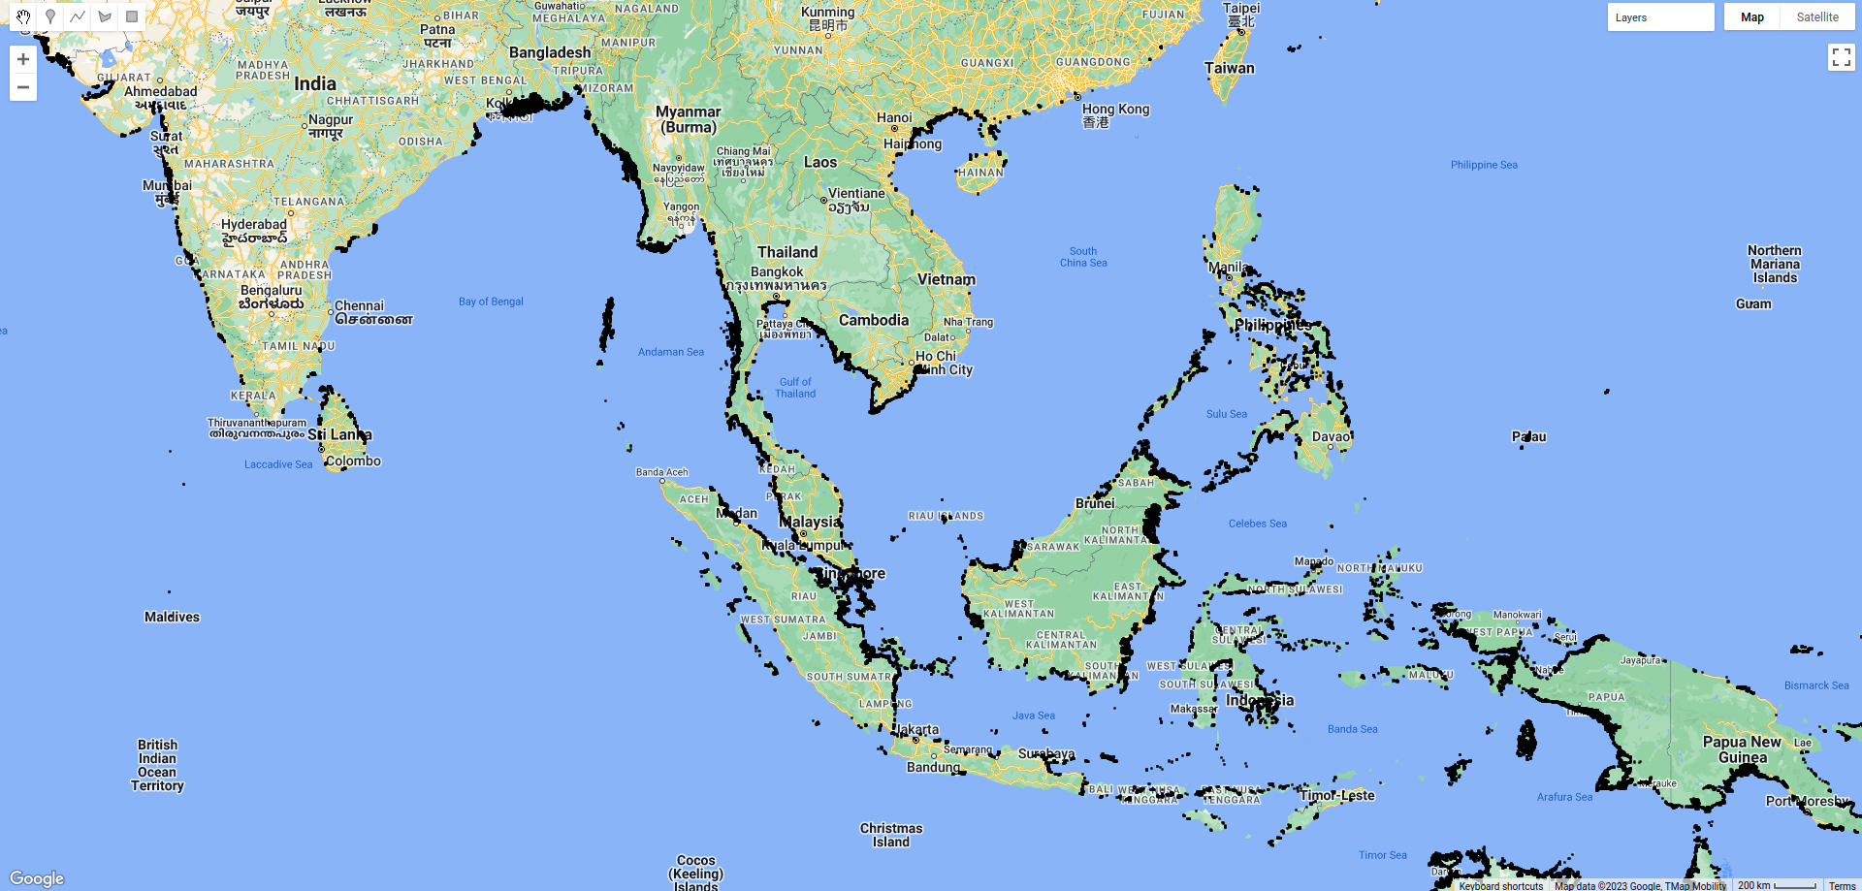
~6 million hectares!

Slide 27

Thank you!

